Slide 1

EMPLOYEE MANAGEMENT

Slide 2

INTRODUCTION
Full Stack Application – Employee Management
A employee management system is an application that is designed to manage all the functions of a employee. It helps librarians to maintain the database of new employee. This system completely automates all your employee activities.
The basic functions of employee management include overseeing all employee operations and managing data.

Slide 3
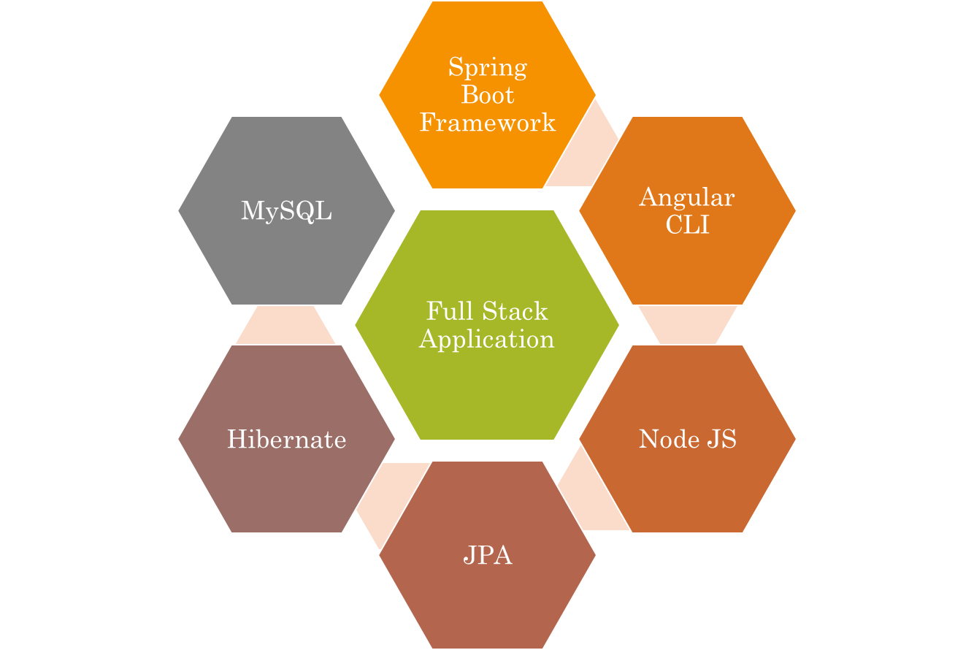
Technologies used.

Slide 4
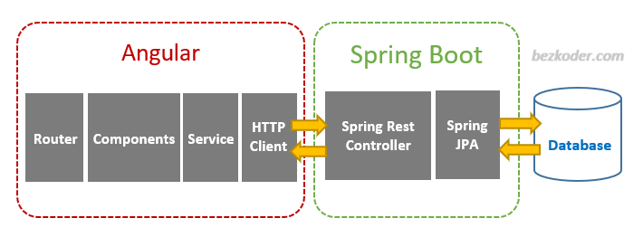


The Architecture of Angular, Spring
& database(MySQL)

Slide 5
The Architecture of the Project
Angular JS
Node JS
Frontend
Spring Boot
Backend
MySQL

Slide 6
CRUD Operations
insert Record
Update Record
Delete Record
CRUD
Add Record

Slide 7
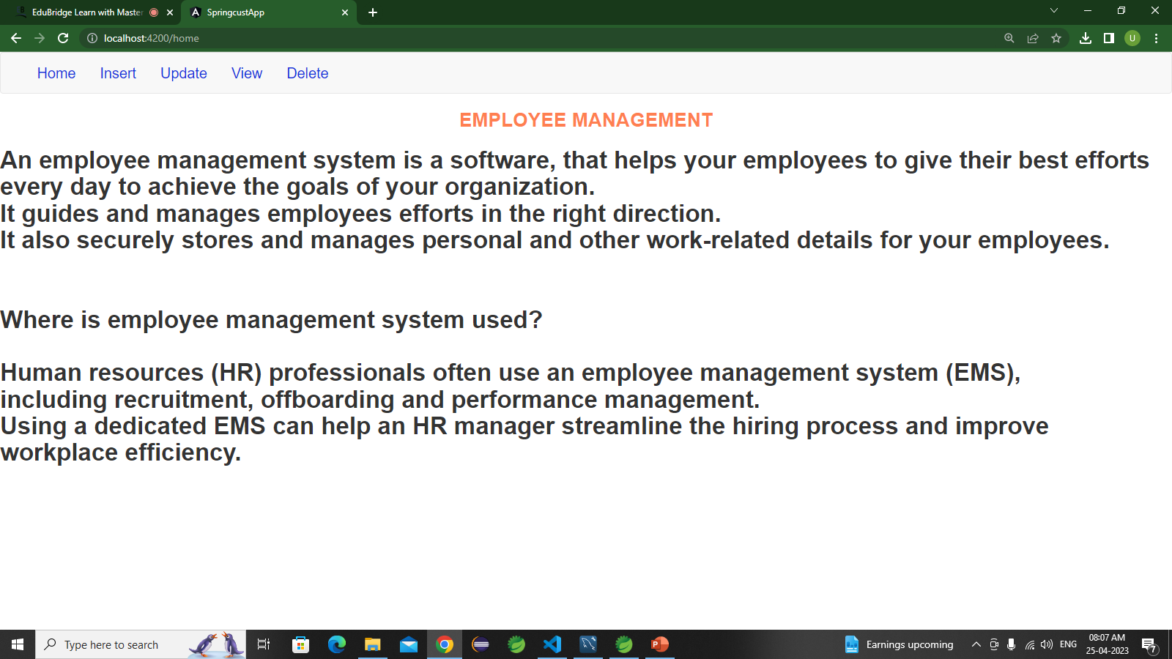
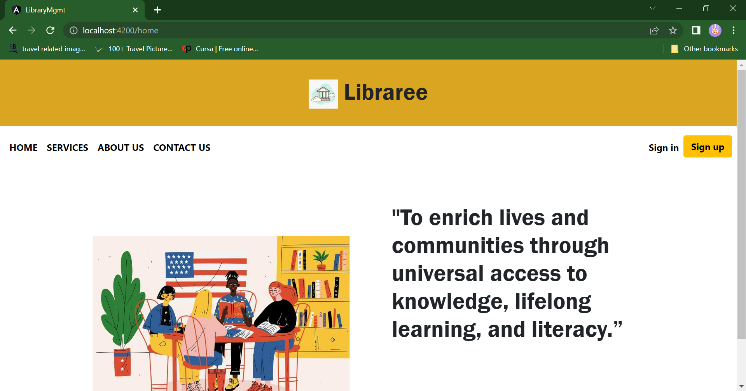
Home Page

Slide 8
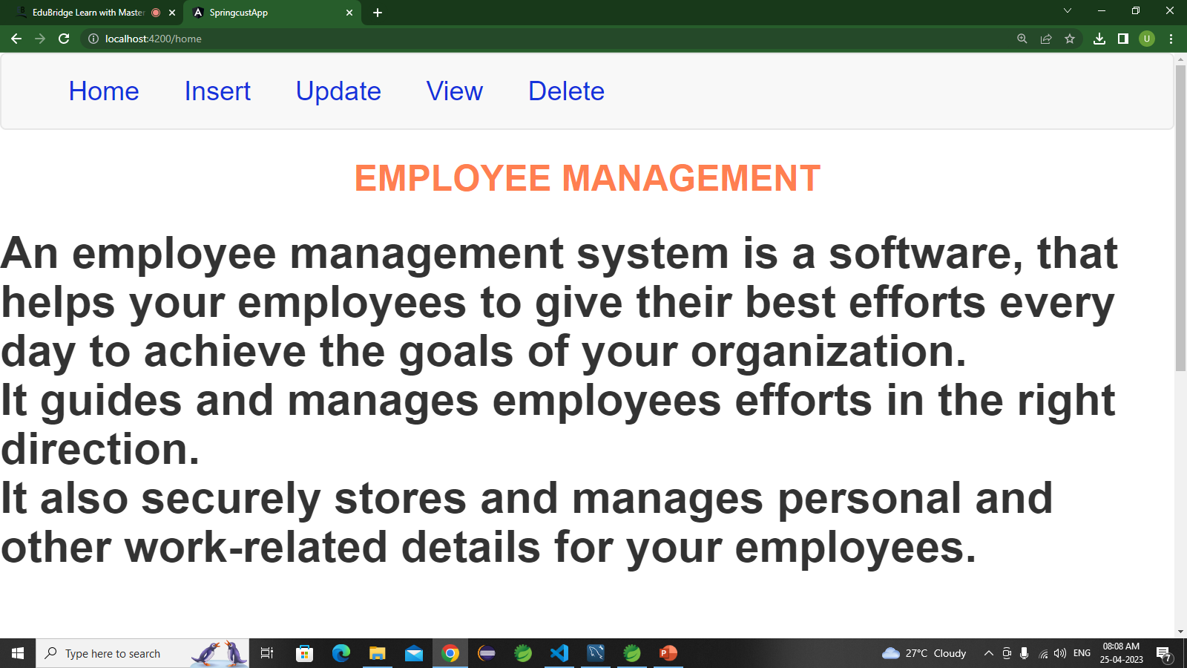
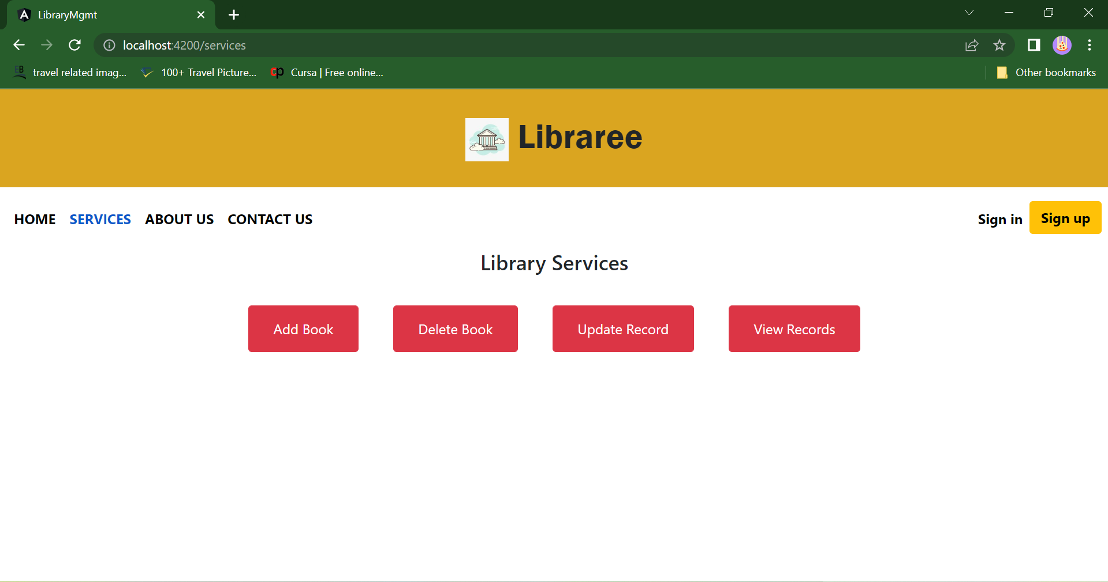
Service Page

Slide 9
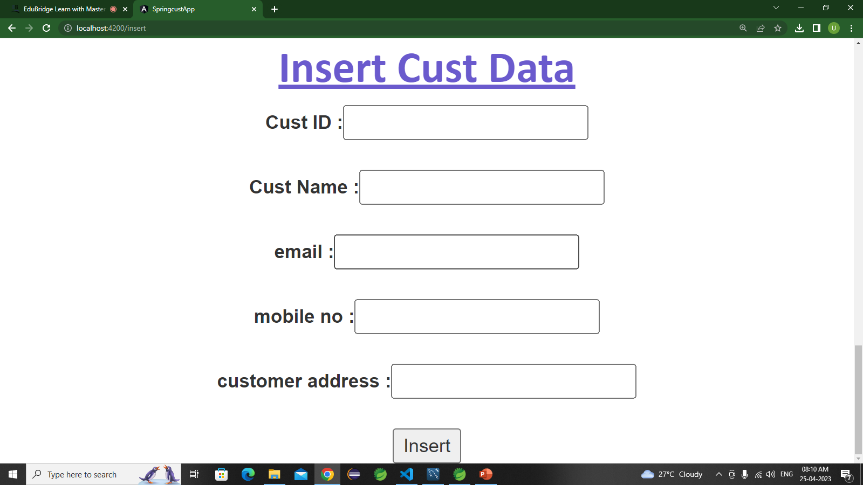
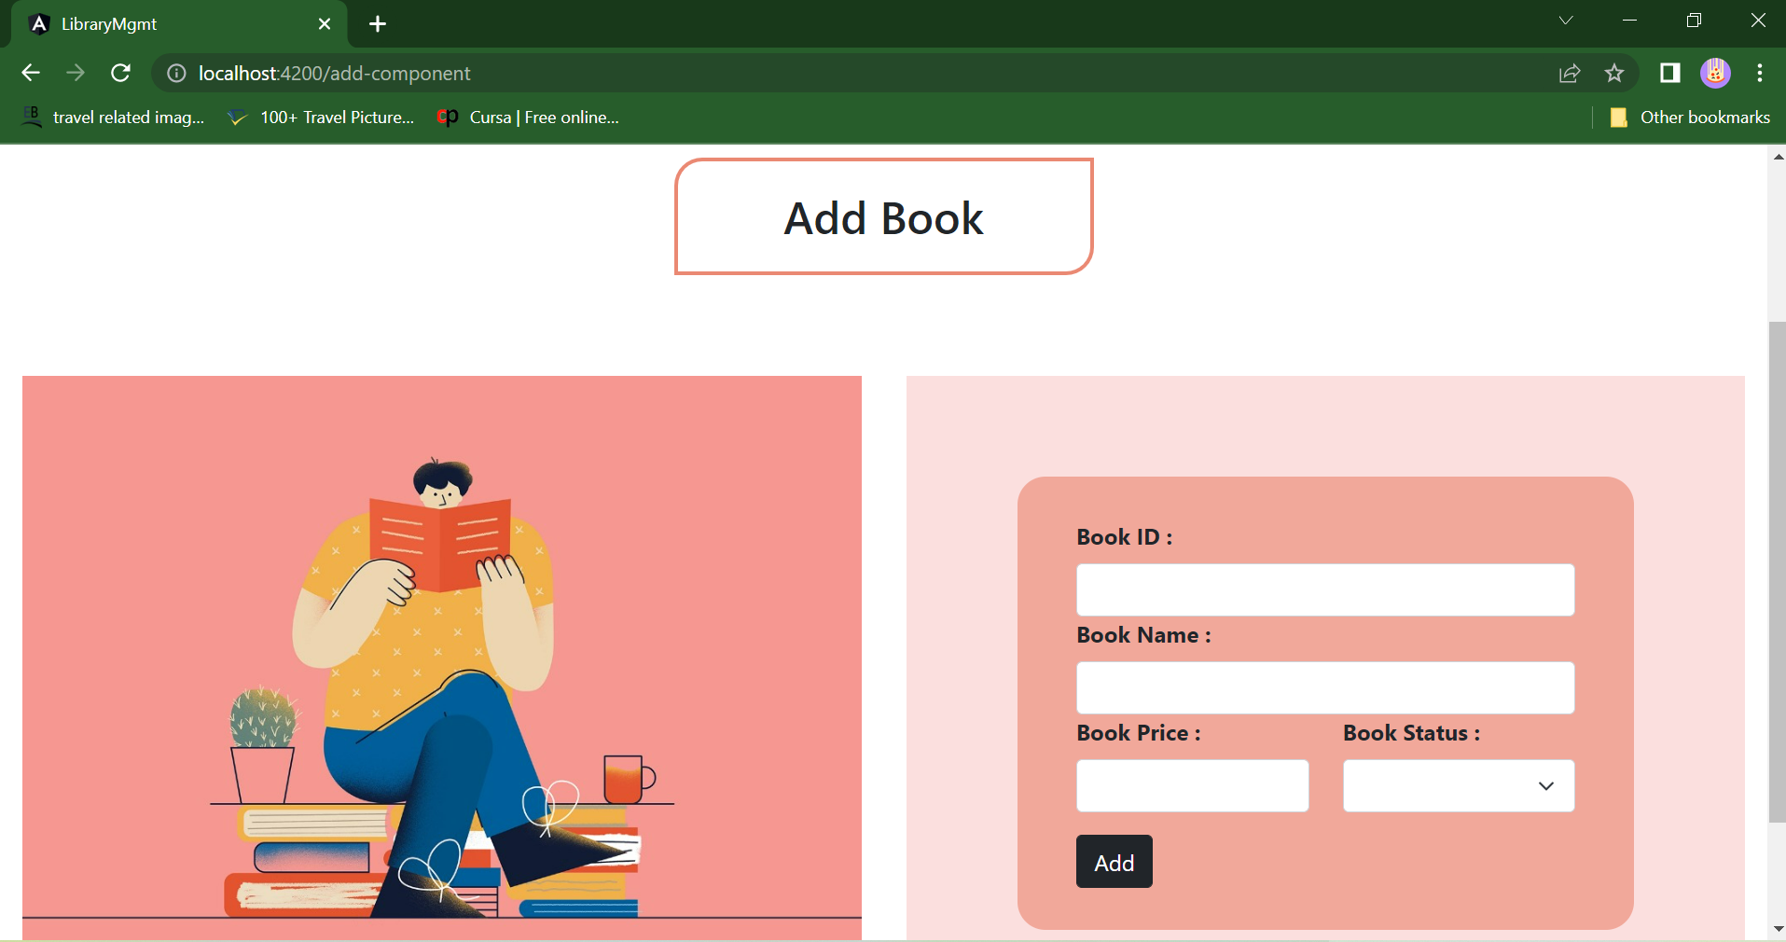
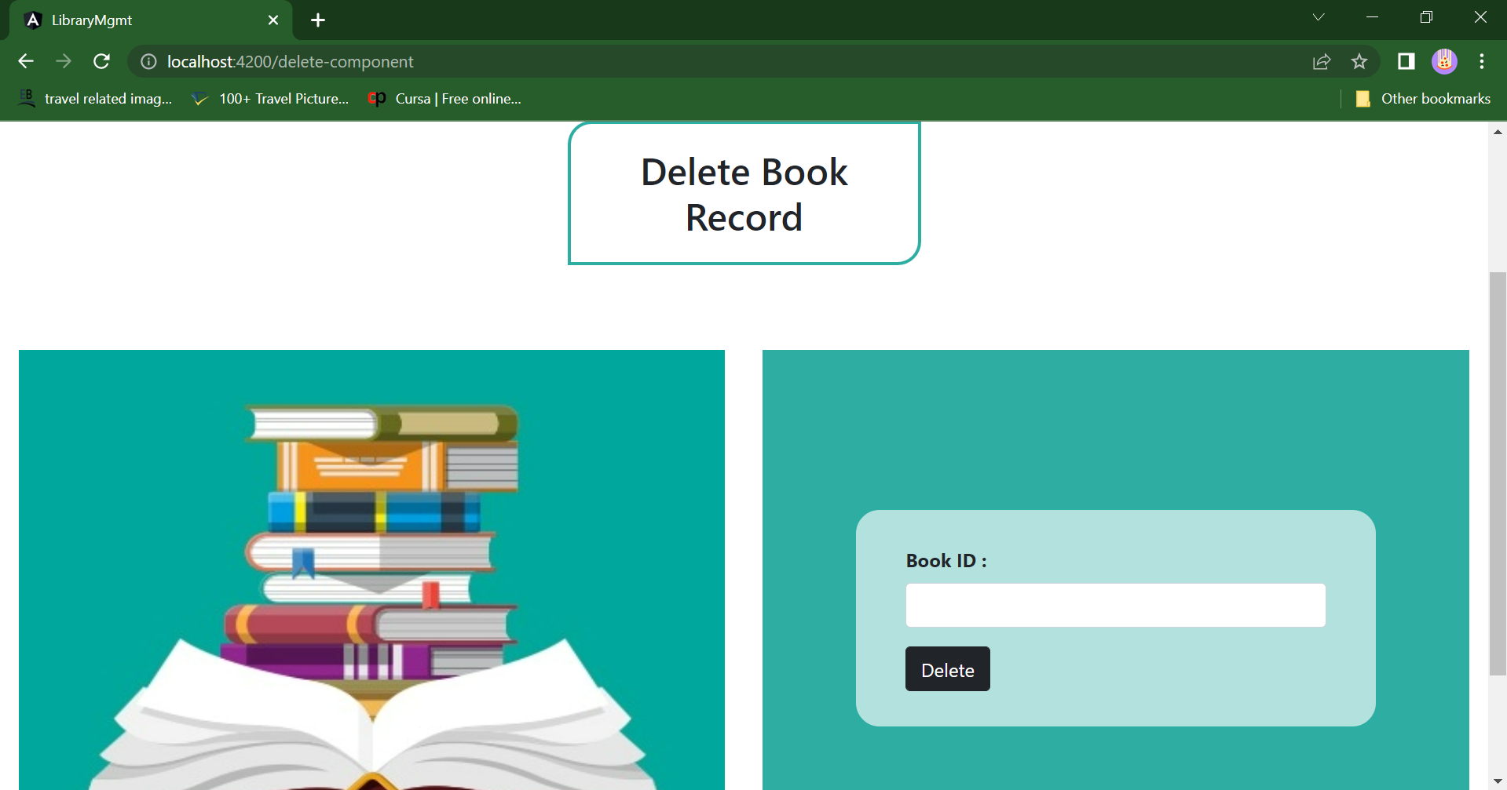
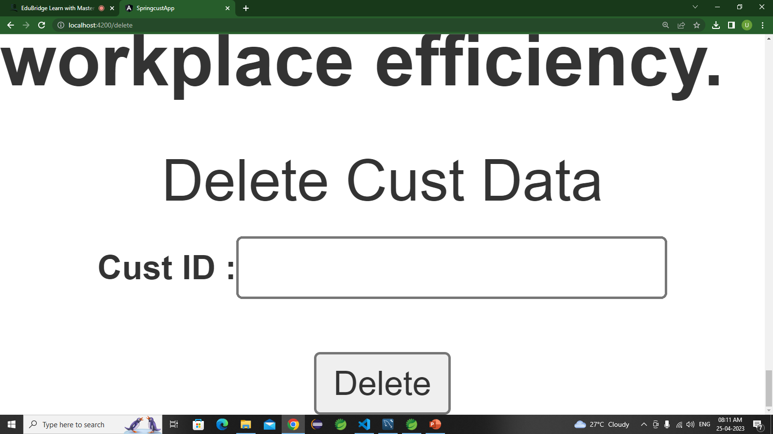
Insert & Delete Page.

Slide 10

Update Page

Slide 11
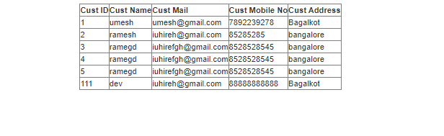
View Record

Slide 12
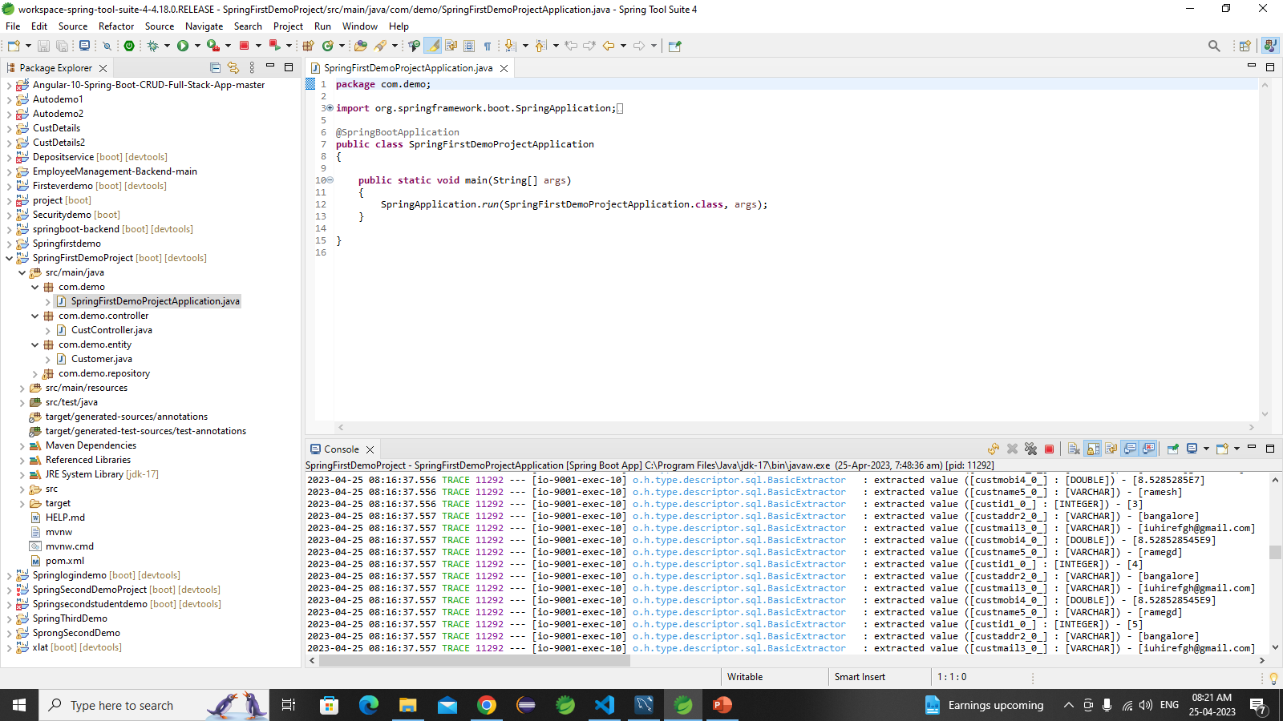
Spring Boot Application

Slide 13
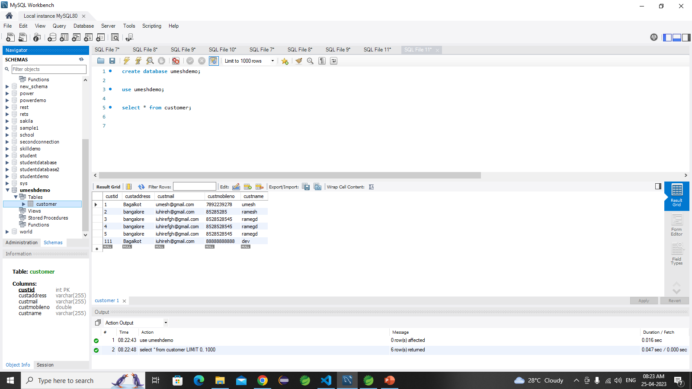
MySQL Code

Slide 14
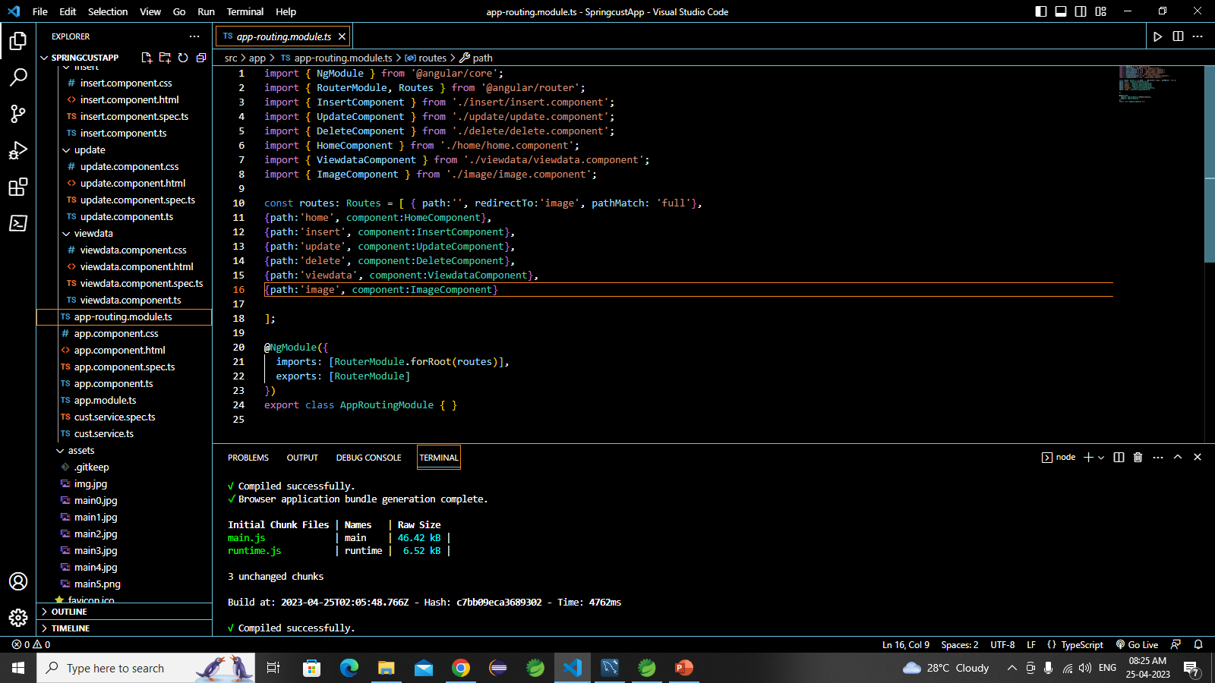
Frontend – Angular JS

Slide 15

The scope of this project is as follows:
To assist the staff in capturing the effort spent on their respective working areas.
To utilize resources in an efficient manner by increasing their productivity through automation.
The system generates types of information that can be used for various purposes.

Slide 16

GitHub Link

Slide 17

Thank you.

